Slide 1


STRCUU Training on Scientific Writing and Preparing Policy Briefs
Dates: 23 – 26 March 2026
Time: 14:00-17:00 EAT

Slide 2

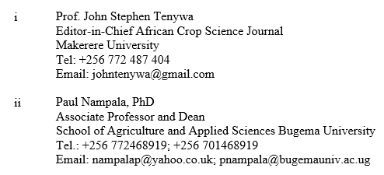
Opening Remarks
Project Partners
Lead Convenor
Facilitators

Slide 3
Write-shop goal & objectives
Goal: Enhance participants’ capacities for crafting coherent and inspiring journal manuscripts for publication in impactful journals
Objectives: By the end of the write-shop, participants will be able:
Transition from a thesis or raw data to a structured, high-impact journal article;
Navigate the IMRAD and other structured components of a journal manuscript;

Slide 4
Objectives……………………
Develop the resilience and technical skill to respond effectively to reviewer feedback and editorial decisions;
Understand ethical standards to protect and promote research integrity;
Identify reputable international and regional journals suited to your manuscript; and
Craft Policy briefs from research-based results, into simple non-scholarly jargon, empirical based data-supported guiding documents

Slide 5
Learning Outcomes
By the end of this training, participants will be able to:
Transition from a thesis or raw data to a structured, high-impact journal article;
Navigate the IMRAD and other structured components of a journal manuscript;
Develop the resilience and technical skill to respond effectively to reviewer feedback and editorial decisions;
Understand ethical standards to protect and promote research integrity;
Identify reputable international and regional journals suited to your manuscript; and,
Craft Policy briefs from research-based results, into simple non-scholarly jargon, empirical based data-supported guiding documents

Slide 6
Day 1: Foundations of Scholarly Publishing
Reasons for publishing
Reasons for rejection of manuscripts: Common mistakes in crafting journal manuscripts
Transitioning from a project report/thesis to a journal manuscript draft

Slide 7
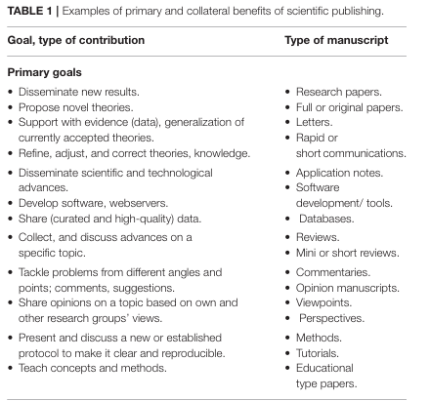
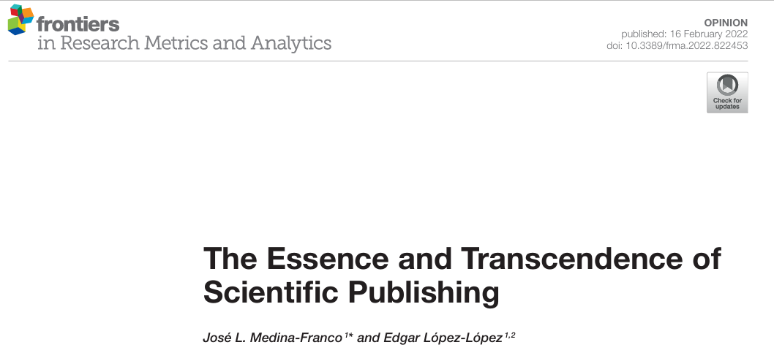
Reasons for publishing

Slide 8
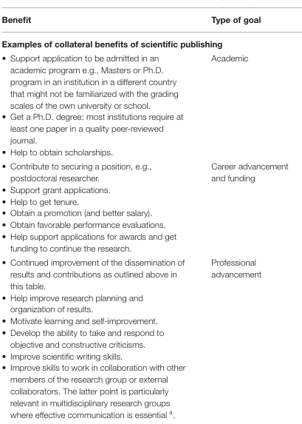
Reasons for publishing

Slide 9
Reasons for Publishing
Motivations for writing journal manuscripts
Publishing in academia is more than just adding to your CV
  —it’s a way of contributing to knowledge, shaping conversations, and serving communities
  - Publishing in academia is not just about personal achievement—it is about stewardship of knowledge

Slide 10
1. Contributing to Knowledge
Academic publishing allows you to share discoveries, insights, and innovations with the wider scholarly community
It ensures that your work becomes part of the collective record
  advancing understanding in your field

Slide 11
2. Professional Growth
Publications demonstrate expertise and credibility, strengthening your academic profile
They are often essential for career progression in teaching, research, and policy roles

Slide 12
3. Influence and Impact
Publishing enables you to shape debates and inform practice—whether in your discipline or other domains in scholarship and linkages with society
Your findings can influence policy, guide practitioners, and inspire further research

Slide 13
4. Collaboration and Networking
Academic articles connect you with other scholars globally
They open doors to securing grants, collaborations, conferences, and joint projects, expanding your reach beyond borders

Slide 14
5. Service to Society
Research published in accessible formats can benefit communities directly, especially when addressing local challenges.
Publishing is a form of community service—sharing insights that nurture community growth and practical service

Slide 15
6. Accountability and Rigor
Peer review ensures that your work is tested, refined, and validated
This process strengthens the quality of your research and builds trust in your contributions

Slide 16
7. Legacy and Mentorship
Publications leave a lasting record of your ideas and service
They also inspire students and younger scholars, offering models of rigorous and impactful scholarship

Slide 17
Reasons for rejection of manuscripts: Common mistakes in crafting journal manuscripts

Slide 18
Common reasons for journal manuscript rejection
Weak or unclear research questions
Poor methodology
Inadequate data analysis
Lack of originality
Poor writing quality
Failure to follow journal guidelines
  Many rejections occur before peer review due to technical errors or scope mismatch.

Slide 19
1. Weak Research Foundation
Unclear hypothesis or objectives: The research question is vague or not academically valid
Lack of novelty: The study does not add new insights or replicate existing work without justification
Weak rationale: The motivation for the study is not compelling

Slide 20
2. Methodological Issues
Inappropriate methodology: Using outdated or unsuitable methods for the research question
Incomplete data: Small sample size, missing controls, or insufficient experiments
Poor statistical analysis: Incorrect tests or lack of statistical rigor

Slide 21
3. Technical and Editorial Errors
Failure to meet journal scope: Submitting to a journal that does not cover the topic
Missing elements: Title, author details, references, figures, or tables not properly included
Language quality: Poor grammar, unclear writing, or lack of logical flow
Simultaneous submissions: Sending the same manuscript to multiple journals at once

Slide 22
4. Ethical Concerns
Plagiarism or self-plagiarism: Copying text without proper citation
Data fabrication or manipulation: Unethical practices that undermine credibility
Failure to obtain ethical approval: Especially in studies involving human or animal subjects

Slide 23
5. Presentation Problems
Poor structure: Manuscripts not following IMRAD (Introduction, Methods, Results, Discussion)
Weak abstract: Fails to summarize the study clearly
Inconsistent referencing: Incorrect citation style or missing references
Figures and tables: Low-quality visuals or misaligned with text

Slide 24

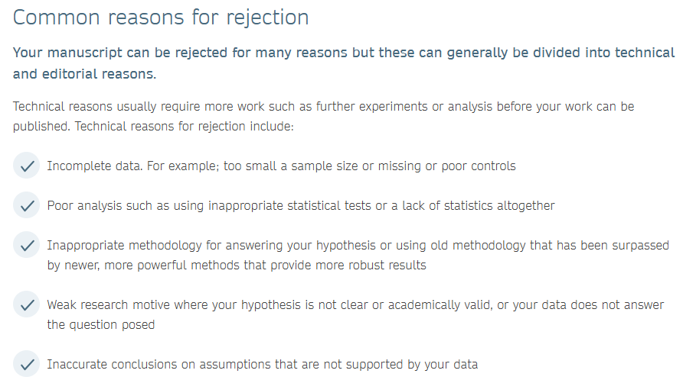

Slide 25
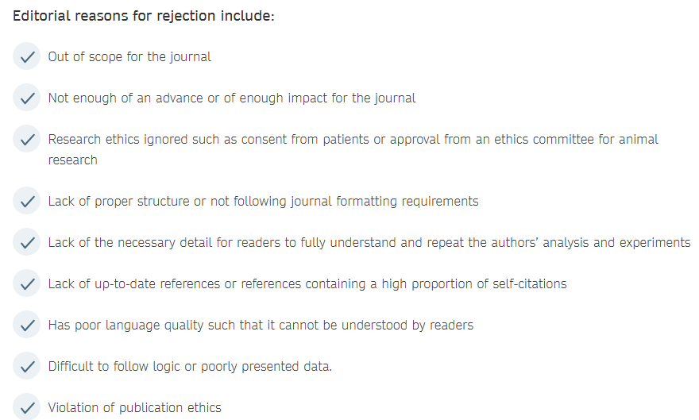

Slide 26
Challenges in writing journal manuscripts
Specific challenges
Knowing what to do
Knowing where to start
Having what to write about
Knowing the difference between what is publishable in journals
Identifying what in a project report or thesis, should be published in journals
Knowing how much of the thesis should fit in a journal manuscript
Getting lost in the document while writing
Knowing when to stop writing a manuscript
Knowing how to size a manuscript
…

Slide 27
Knowing what good journals are interested in
Knowing the readers’ interests
Writing a research story, focused and inspiring to the reader
Dividing datasets to write several papers
Trying to fit whole thesis or project report in one manuscript
Assuming that a journal manuscript is another type of report
Distinguishing the different thrusts among reports, theses and journal papers

Slide 28
System challenges
Limited writing skills
Lack of peer pressure
Lack of research results

Slide 29
Transitioning from a project report/thesis to a journal manuscript draft

Slide 30
Understand and Appreciate the Difference
A Thesis is comprehensive and research-focused, aimed at earning a degree
A Project Report is practical, documenting applied work or interventions
A Journal Article is concise, peer-reviewed, and intended for global dissemination of new knowledge

Slide 31
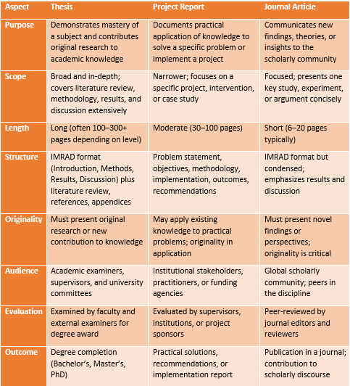

Slide 32
Important assumptions to getting started
A well designed and science-premised study was conducted to address a significant problem using the best-bet materials and methods
The study was replicated and repeated adequately based on current expectations by our profession
Data were collected using the profession’s procedures (including statistics) in the sequence outlined in the well thoughtout research proposal used to guide the study

Slide 33
The authors possess the minimum knowledge of statistics required to evaluate data from different analytical procedures as well as interpret then objectively (GIGO)
Data from the project/thesis were carefully handled and analysed using conventionally acceptable procedures

Slide 34
The right statistics were selected for analysis to permit objective interpretation of the data in the illustrations (LSD, SE, CV, etc.)
The most effective illustrations (Tables, Figures, Plates, Maps, etc.) were developed from the statistical analysis/GIS outputs

Slide 35

Suggested steps in developing the article
Evaluate the project/thesis objective & identify scholarly segments/themes that can constitute publishable messages
Turn each selected segment/theme into an objective for a potential manuscript

Slide 36
Select illustrations (e.g. Tables/Figures/Plates) that can be aligned behind the selected theme to support delivery of a message
Think of a story (independent of the project/thesis) that will constitute the message to be delivered thru the paper/manuscript

Slide 37
Start writing the manuscript
Keep refining the manuscript iteratively
Develop the title that most represents the contents of the paper. This is often linked to the objective and conclusion of the paper
Give to co-authors or friends to read through

Slide 38
EXAMPLE: Project/Study
A study involved groundnut and French bean each grown with sorghum as intercrops in western Kenya
Objectives of study/project
  improve the agronomic performance and economic value of sorghum-legume intercrops in western Kenya
  Increase awareness of ………………..

Slide 39
Agronomic evaluation
  Treatments:
  Row arrangement: 1:1 & 2:2 (MBILI)
  Row orientations: North-South; East-West
  N rates: 0, 40 kg ha⁻¹

Slide 40
Parameters measured
Solar radiation
Plant heights
No of pods per plant
Leaf area index
Time to flowering
BNF
Time to maturity
No of seeds per pod

Slide 41
100 seed weight
Panicle size
100 grain weight
Protein content
Days to harvesting
Grain yield data

Slide 42
Economics assessment:
Variables:
  Farm gate prices
  Variable input costs
  … etc
Create awareness……………….
  There are no dissemination parameters because dissemination was not a research objective

Slide 43
  Using the above project/thesis example, the themes would be:
  Agronomic performance
    Datasets – groundnut/sorghum (1 paper)
        – French bean/sorghum (1 paper)
  Economic value:
  - Groundnut/sorghum (1 paper)
  - French bean/sorghum (1 paper)

Slide 44
  Relative performance of common bean-sorghum and French bean-sorghum ……….. (1 paper)
  Dissemination was a development activity – may not merit a scholarly paper

Slide 45
STRCUU Training on Scientific Writing and Preparing Policy Briefs
End of Day 1
Dates: 23 – 26 March 2026
Time: 14:00-17:00 EAT

